Slide 1
The Honey Bee

Slide 2
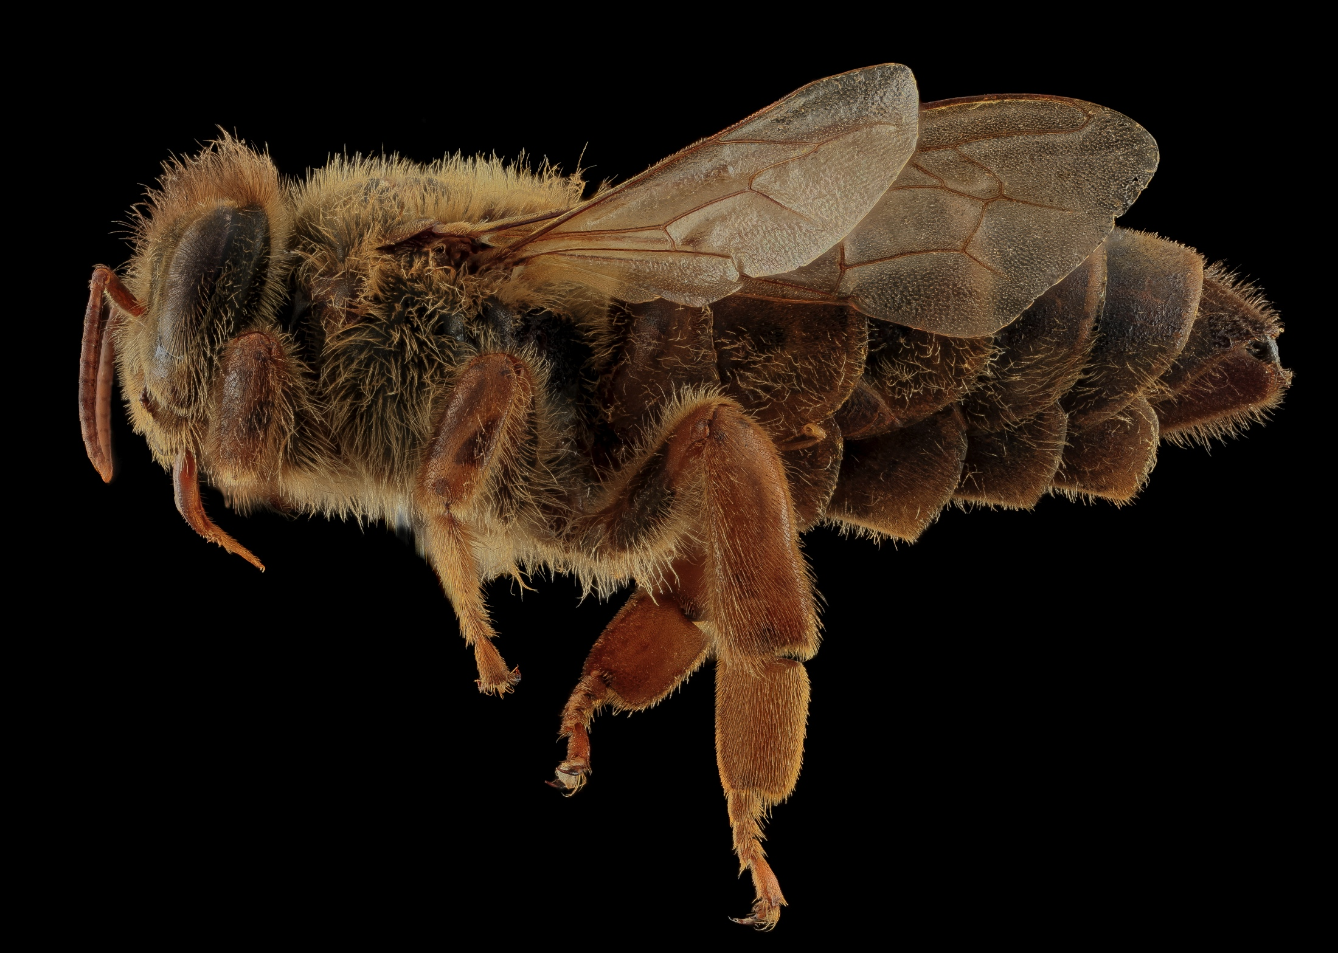
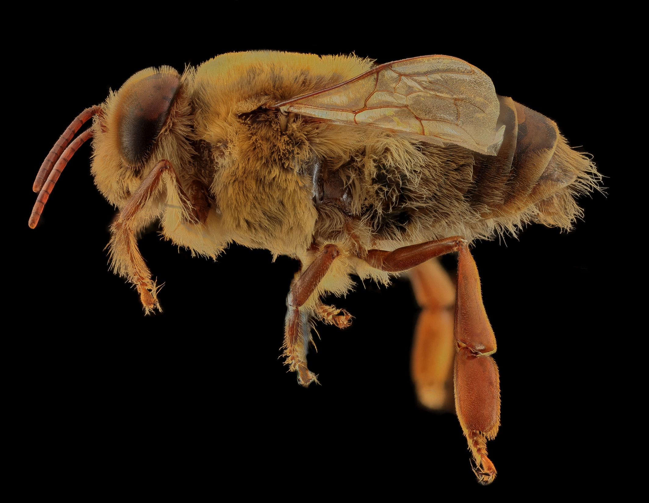
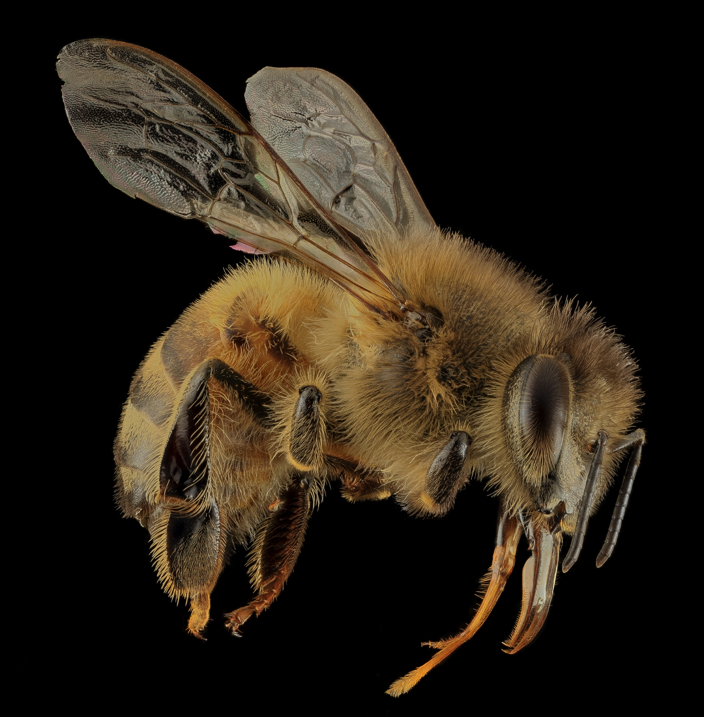
There are 3 types, or castes, of honey bees.
Queen
Drone
Worker
Photo Credit USGS

Slide 3
A honey bee has 3 main body regions — head, thorax, and abdomen.
Thorax
thorax
Abdomen
Head
Photo Credit USGS

Slide 4
The worker bee’s head contains 2 compound eyes, 2 antennae, a pair of mandibles, and the proboscis.
Photo credit USGS

Slide 5
The two compound eyes are made up of thousands of tiny lenses that allow the bee to see ultraviolet light, which is invisible to the human eye.
Photo Credit USGS

Slide 6
The simple eyes each have a thick lens that can sense changes in brightness. A honey bee has three simple eyes on top of its head, but only one can be seen here.
Photo Credit USGS

Slide 7
The honey bee’s antennae are movable feelers that detect smells and movement.
Photo credit USGS

Slide 8
The proboscis is a straw-like tongue used to suck nectar or honey.
Photo Credit Dalantech

Slide 9
Mandibles are a pair of jaw-like structures used to knead wax, chew honey and pollen, and bite tiny invaders when defending the hive.
Photo credit USGS

Slide 10
The thorax is the honey bee’s middle region containing the flight muscles, 4 wings, and 6 legs.
Photo credit USGS

Slide 11
A honey bee has 2 hind wings and 2 forewings. Its wings beat 250 times a second allowing the bee to fly at speeds of up to 15 miles per hour.
Forewing
Hind Wing
Photo Credit USGS

Slide 12
A honey bee has 3 pairs of segmented legs used for walking, dusting their antennae, brushing pollen off body hairs, and storing pollen.
Photo Credit USGS

Slide 13
The hind legs of a worker bee contain a pollen basket–a collection of hairs where pollen is stored for transport.

Slide 14
The abdomen is the honey bee’s rear region that contains organs for digestion, reproduction, and respiration as well as the worker and queen bees’ stingers and the worker’s wax glands.
Photo Credit USGS

Slide 15
The stinger is only found in female honey bees. A worker bee’s barbed stinger is used for defense. A queen bee’s smooth stinger is used for eliminating rival queens.
Photo Credit Max Westby

Slide 16
The honey sac is an internal, stomach-like organ where nectar is stored.
Photo Credit USGS

Slide 17
Wax glands are located on the underside of the worker bee’s abdomen. The glands form and excrete wax.

Slide 18
A honey bee has 4 distinct life stages — egg, larva, pupa, and adult. The queen lays each egg into a different cell of the honeycomb.

Slide 19
After 3 days, the egg hatches, and a worm-like creature, called a larva, crawls out. Worker bees feed the larva royal jelly. As it grows, the larva sheds its skin 4-5 times. On day 9, the larva spins itself into a cocoon, and a worker bee seals the cocoon into the cell with wax.

Slide 20
Inside the cocoon, the larva transforms into a pupa, developing eyes, legs, and wings.

Slide 21
When the bee is fully grown, it chews its way out of the cell and emerges as an adult.
Photo Credit Max Westby

